Slide 1


إستخدام تقنية العناصر الدقيقة في تطوير تصميم معدات الحراثة
Using Finite Element Technology in Development of Tillage Equipment Design

Slide 2
Tillage Operation
Tillage operation is the mechanical manipulation of the soil for preparing the seedbed. It must provide the suitable environment for the plant growth, with have the optimum soil structure with minimum large aggregates.

Slide 3
Tillage operation is consuming more than 50% of the total required energy in the whole agricultural operation (Raper et al., 2000).
The soil-tillage tool interaction modeling mainly aimed to simulate the forces and displacement of soil cut for decreasing the energy use.

Slide 4
Simulation Soil-Tillage Tool Interaction
Simulation can accurately model the interaction between the soil and tool cutting edge. Energy efficient tools can be designed without performing expensive field tests.

Slide 5
Methods for Studying the Interaction of Soil and Tillage Tools

Slide 6
Finite Element Method (FEM)
Finite element method (FEM) is a numerical method used to analyze complex engineering problems that difficult to solve by traditional methods. It depends on dividing the system into a number of finite elements that dealt and solved separately and then compiled the results to obtain the final solution.

Slide 7
Steps of Finite Element Analysis
Mesh Generation
Choose the Model
Solve Equations of Model
Assemble the Results

Slide 8
Advantages of Finite Element Method
Deal with Complicated Shapes
Heterogeneous Material Analysis
Provide Accurate Insights for
Behavior of Systems

Slide 9
Programs of Finite Element Method
ANSYS
ABAQUS
COMSOL
SOLID WORKS SIMULATION

Slide 10
Applications of FEM in Agr.Eng.
Agricultural Machinery Design
Soil and Water Analysis
Simulation the Impact of Mechanical
Loads
Analysis of Irrigation Systems

Slide 11
FEM For Soil-Tillage Tool Interaction
Finite element method (FEM) is a numerical method which can replace the field experiments for optimizing tillage tool design and for better understanding the operational conditions of tillage forces and the quality of tillage operation.

Slide 12
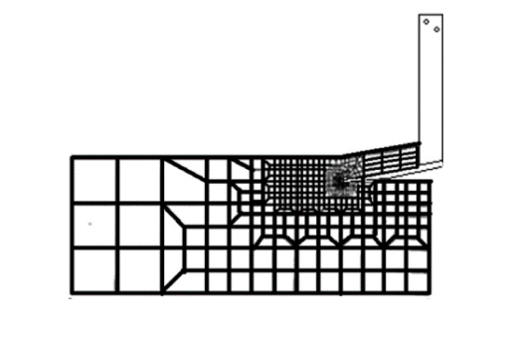
Modeling the Interaction of Soil Tillage Tool Using FEM

Slide 13
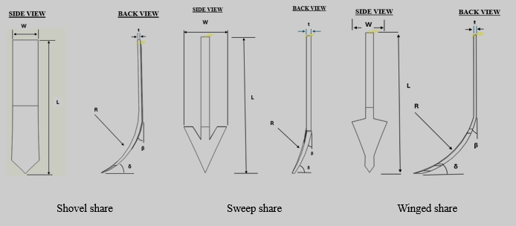
Tillage Tools

Slide 14
Input Parameters for FEM
Soil Parameters
Density
Young’s modulus
Poisson’s ratio
Internal friction angle.
stress ratio
Dilatation angle
Tool Parameters
Depth
Width
Rack angle
Speed
Soil-Tool Interaction
Soil-metal coefficient of friction.
Soil-metal friction angle.

Slide 15
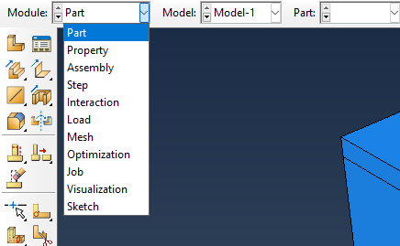
Finite Element Model Using ABAQUS
Part
Property
Assembly
Step
Interaction
Load
Mesh
Job

Slide 16
Results of Finite Element Analysis

Slide 17
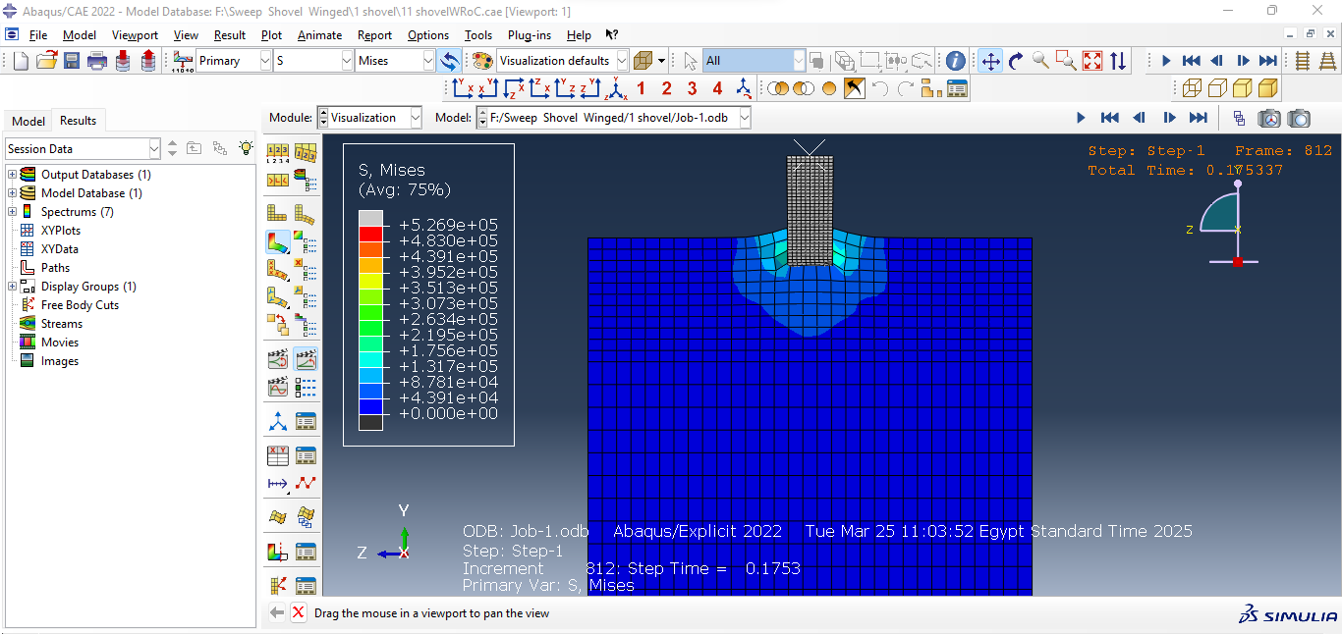

Slide 18
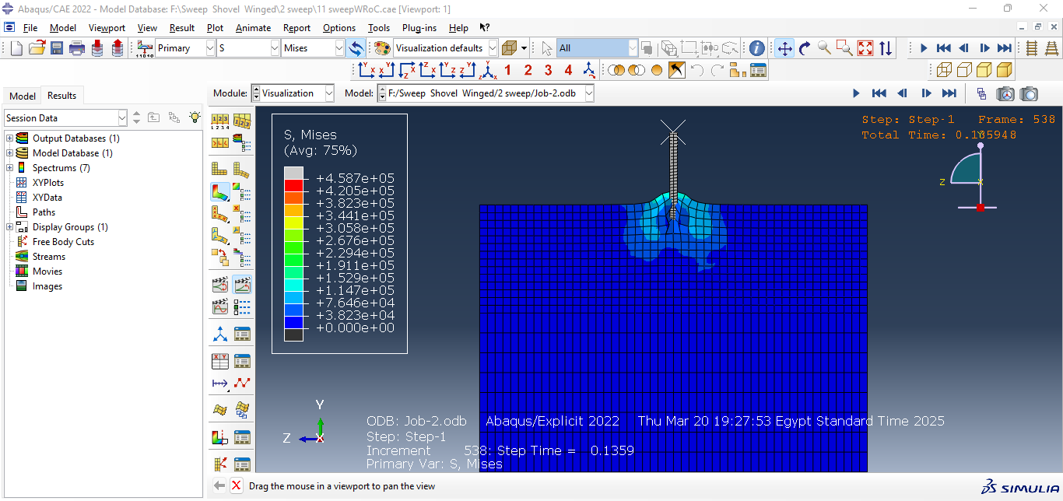

Slide 19
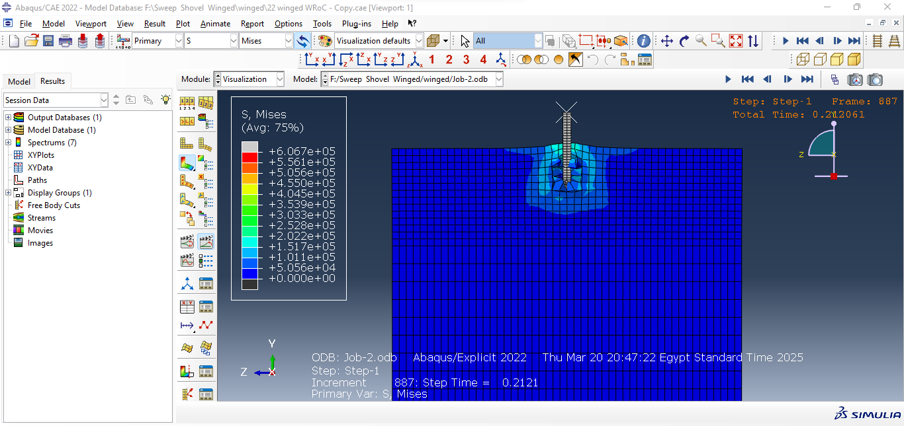

Slide 20
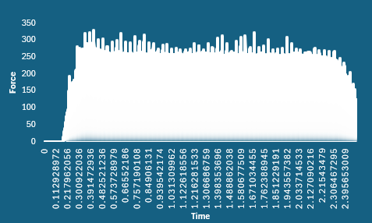

Slide 21
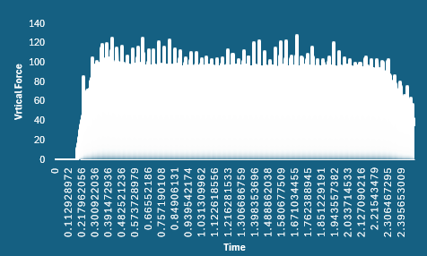

Slide 22
